Slide 1

Intro to object-oriented programming
Chapter 7 - pygwidgets

Slide 2
CHAPTER 7 – PYGAME GUI WIDGETS
Pygame allows programmers to take the text-based language of Python and use it to build GUI-based programs. Windows, pointing devices, clicking, dragging, and sounds have all become standard parts of our experience using computers. Unfortunately, the pygame package doesn’t come with built-in basic user interface elements, so we need to build them ourselves. We’ll do so with pygwidgets, a library of GUI widgets.
This chapter explains how standard widgets such as images, buttons, and input or output fields can be built as classes and how client code uses them. Building each element as a class allows programmers to incorporate multiple instances of each element when creating a GUI. Before we get started building these GUI widgets, however, I first need to discuss one more Python feature: passing data in a call to a function or method.

Slide 3
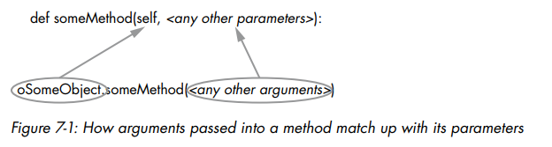
Passing Arguments into a Function or Method
The arguments in a call to a function and the parameters defined in the function have a one-to-one relationship, so that the value of the first argument is given to the first parameter, the value of the second argument is given to the second parameter, and so on.
Figure 7-1, duplicated from Chapter 3, shows that the same is true when you make a call to a method of an object. We can see that the first parameter, which is always self, is set to the object in the call.

Slide 4
Passing Arguments into a Function or Method
However, Python (and some other languages) allows you to make some of the arguments optional. If an optional argument isn’t provided in a call, we can provide a default value to use in the function or method instead. I’ll explain by means of a real-world analogy.
If you order a hamburger at a Burger King restaurant, your burger will come with ketchup, mustard, and pickles. But Burger King is famous for saying, “You can have it your way.” If you want some other combination of condiments, you must say what you want (or don’t want) when you make your order. We’ll start by writing an orderBurgers() function that simulates making a burger order in the regular way we’ve been defining functions, without implementing default values:
def orderBurgers(nBurgers, ketchup, mustard, pickles):

Slide 5
PASSING ARGUMENTS INTO A FUNCTION OR METHOD
You must specify the number of hamburgers you want to order, but ideally, if you want the defaults of True for adding ketchup, mustard, and pickles, you shouldn’t need to pass in any more arguments. So, to order two hamburgers with the standard defaults, you might think your call should look like this:
orderBurgers(2) #with ketchup, mustard, and pickles
However, in Python, this will trigger an error because there is a mismatch between the number of arguments in the call and the number of parameters specified in the function:
TypeError: orderBurgers() missing 3 required positional arguments: 'ketchup', 'mustard', and 'pickles'
Let’s see how Python allows us to set up optional parameters that can be given default values if nothing is specified

Slide 6

Positional and Keyword Parameters
Python has two different types of parameters: positional parameters and keyword parameters. Positional parameters are the type that we’re already familiar with, where each argument in a call has a matching parameter in the function or method definition.
A keyword parameter allows you to specify a default value. You write a keyword parameter as a variable name, an equal sign, and a default value, like this:
You can have multiple keyword parameters, each with a name and a default value.
A function or method can have both positional parameters and keyword parameters, in which case you must specify all positional parameters before any keyword parameters:

Slide 7
POSITIONAL AND KEYWORD PARAMETERS
Let’s rewrite orderBurgers() to use one positional parameter and three keyword parameters with default values, like this: def orderBurgers(nBurgers, ketchup=True, mustard=True, pickles=True):
When we make a call to this function, nBurgers is a positional parameter and therefore must be specified as an argument in every call. The other three are keyword parameters. If no values are passed for ketchup, mustard, and pickles, the function will use the default value of True for each of those parameter variables. Now we can order two burgers with all the condiments like this: orderBurgers(2)
If we want something other than a default value, we can specify the name of the keyword parameter and a different value in our call. For example, if we only want ketchup on our two burgers, we can make the call this way: orderBurgers(2, mustard=False, pickles=False)
When the function runs, the values of the mustard and pickles variables are set to False. Since we did not specify a value for ketchup, it is given the default of True.

Slide 8
POSITIONAL AND KEYWORD PARAMETERS
You can also make the call specifying all arguments positionally, including those written as keyword parameters. Python will use the ordering of your arguments to assign each parameter the correct value: orderBurgers(2, True, False, False)
In this call, we are again specifying two burgers with ketchup, no mustard, and no pickles

Slide 9


Additional Notes on Keyword Parameters
Let’s quickly go over a few conventions and tips for using keyword parameters. As a Python convention, when you use keyword parameters and keywords with arguments, the equal sign between the keyword and the value should not have spaces around it, to show that these are not typical assignment statements. These lines are properly formatted:
These lines will also work fine, but they don’t follow the formatting convention and are less readable:
When calling a function that has both positional parameters and keyword parameters, you must provide values for all the positional parameters first, before any optional keyword parameters.

Slide 10
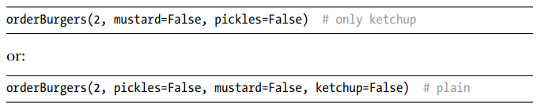
ADDITIONAL NOTES ON KEYWORD PARAMETERS
Keyword arguments in calls can be specified in any order. Calls to our orderBurgers() function could be made in various ways, such as:
All keyword parameters will be given the appropriate values, independent of the order of the arguments.
While all the default values in the orderBurgers() example were Boolean values, a keyword parameter can have a default value of any data type. For example, we could write a function to allow a customer to make an ice cream order like this:
The caller must specify a flavor, but by default will get one scoop in a cone with no sprinkles. The caller could override these defaults with different keyword values.

Slide 11
Using None as a Default Value
It’s sometimes helpful to know whether the caller passed in a value for a keyword parameter or not. For this example, the caller orders a pizza. At a minimum, the caller must specify a size. The second parameter will be a style that defaults to 'regular' but could be 'deepdish'. As a third parameter, the caller can optionally pass in a single desired topping. If the caller wants a topping, we must charge them extra.
In EXAMPLE, we’ll use a positional parameter for the size and keyword parameters for the style and topping. The default for style is the string 'regular'. Since the topping choice is optional, we’ll use the special Python value of None as the default, but the caller may pass in the topping of their choice
EXAMPLE: A function with a keyword parameter defaulting to None
The first and second calls would be seen as the same, with the value of the variable topping set to None. In the third and fourth calls, the value of topping is set to 'mushrooms'. Because 'mushrooms' is not None, in these calls the code would add in an extra charge for a topping on the pizzas. Using
None as a default value for a keyword parameter gives you a way to see if the caller provided a value in the call. This may be a very subtle use of keyword parameters, but it will be very useful in our upcoming discussion

Slide 12
Default Values in GUI Widgets
In the next section, I’ll present a collection of classes that you can use to easily create GUI elements such as buttons and text fields within pygame. These classes will each be initialized using a few positional parameters but will also have assorted optional keyword parameters, all with reasonable defaults to allow programmers to create GUI widgets by specifying only a few positional arguments. More precise control can be obtained by specifying values to overwrite the default values of keyword parameters.
For an in-depth example, we’ll look at a widget to display text in the application’s window. Text can be shown in a variety of fonts, font sizes, colors, background colors, and so on. We’ll build a DisplayText class that will have default values for all of these attributes but will give client code the option of specifying different values.

Slide 13
The pygwidgets Package
The rest of this chapter will focus on the pygwidgets (pronounced “pig wijits”) package, which was written with two goals in mind:
1. To demonstrate many different object-oriented programming techniques
2. To allow programmers to easily create and use GUI widgets in pygame programs
The pygwidgets package contains the following classes:
TextButton - Button built with standard art, using a text string
CustomButton - Button with custom artwork
TextCheckBox - Checkbox with standard art, built from a text string
CustomCheckBox - Checkbox with custom artwork
TextRadioButton - Radio buttons with standard art, built from a text string
CustomRadioButton - Radio buttons with custom artwork

Slide 14
THE PYGWIDGETS PACKAGE
DisplayText - Field used to display output text
InputText - Field where the user can type text
Dragger - Allows the user to drag an image
Image - Displays an image at a location
mageCollection - Displays one of a collection of images at a location
Animation - Displays a sequence of images
SpriteSheetAnimation - Displays a sequence of images from a single larger image

Slide 15

Setting Up
To install pygwidgets, open the command line and enter the following:
Once installed, you can use pygwidgets by including the following statement at the beginning of your programs:
This imports the entire package. After importing, you can instantiate objects from its classes and call the methods of those objects

Slide 16
Overall Design Approach
As shown in Chapter 5, one of the first things you do in every pygame program is to define the window of the application. The following line creates an application window and saves a reference to it in a variable named window:
As we will soon see, whenever we instantiate any widget, we will need to pass in the window variable so the widget can draw itself in the application’s window. Most widgets in pygwidgets work in a similar way, typically involving these three steps:
1. Before the main while loop starts, create an instance of the widget, passing in any initialization arguments.
2. In the main loop, whenever any event happens, call the handleEvent() method of the widget (passing in the event object).
3. At the bottom of the main loop, call the draw() method of the widget.

Slide 17
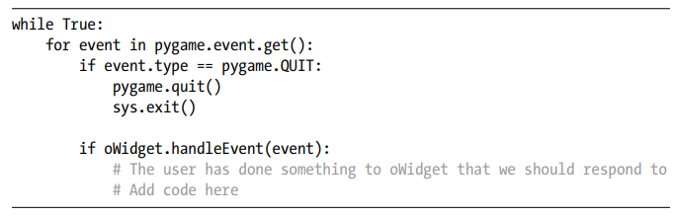
OVERALL DESIGN APPROACH
Step 1 in using any widget is to instantiate one with a line like this:
The first argument is always the window of the application. The second argument is always the location in the window at which to display the widget, given as a tuple: (x, y).
Step 2 is to handle any event that could affect the widget by calling the object’s handleEvent() method inside the event loop. If any event (like a mouse click or button press) happens and the widget handles the event, this call will return True. The code at the top of the main while loop generally looks like this:

Slide 18
OVERALL DESIGN APPROACH
Step 3 is to add a line near the bottom of the while loop to call the draw() method of the widget, to make it appear it in the window:
Since we specified the window to draw into, the location, and any details that affect the appearance of the widget in step 1, we don’t pass anything in the call to draw().

Slide 19
Adding an Image
Our first example will be the simplest widget: we’ll use the Image class to display an image in a window. When you instantiate an Image object, the only required arguments are the window, the location in the window to draw the image, and the path to the image file. Create the Image object before the main loop starts, like so:
The path used here assumes that the project folder containing the main program also contains a folder named images, inside which is the SomeImage.png file. Then, in the main loop you just need to call the object’s draw() method:
The draw() method of the Image class contains a call to blit() to actually draw the image, so you never need to call blit() directly. To move the image, you can call its setLoc() method (short for set location), specifying the new x- and y-coordinates as a tuple:
The next time the image is drawn, it will show up at the new coordinates. The documentation lists many additional methods that you can call to flip, rotate, scale, get the image’s location and rectangle, and so on.

Slide 20
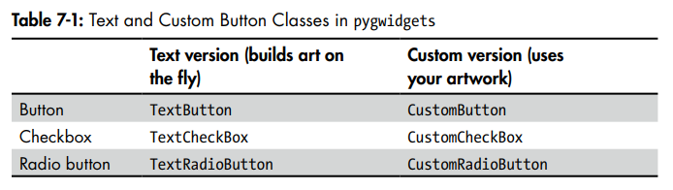
Adding Buttons, Checkboxes, and Radio Buttons
When you instantiate a button, checkbox, or radio button widget in pygwidgets, you have two options: instantiate a text version that draws its own art and adds a text label based on a string you pass in, or instantiate a custom version where you supply the art
The differences between the text and custom versions of these classes are only relevant during instantiation. Once you create an object from a text or custom button class, all the remaining methods of the pair of classes are identical. To make this clear, let’s take a look at the TextButton and CustomButton classes.

Slide 21
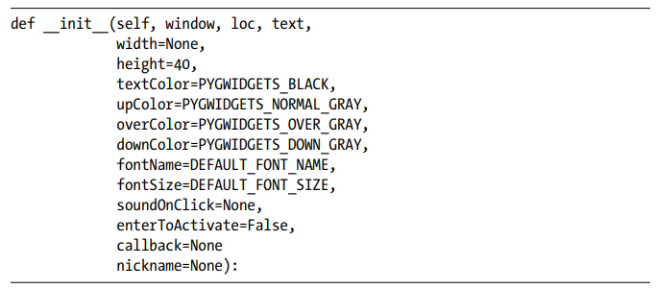
TextButtons
Here is the actual definition of the __init__() method of the TextButton class in pygwidgets:
However, rather than reading through the code of a class, a programmer will typically refer to its documentation. You can also view documentation of a class by calling the built-in help() function in the Python shell like so:

Slide 22
TEXTBUTTONS
When you create an instance of a TextButton, you are only required to pass in the window, the location in the window, and the text to be shown on the button. If you only specify these positional parameters, your button will use reasonable defaults for the width and height, the background colors for the four states of the button (different shades of gray), the font, and the font size. By default, no sound effect will be played when the user clicks on the button.
The code to create a TextButton using all the defaults looks like this:
The code in the __init__() method of the TextButton class uses the pygame drawing methods to construct its own art for all four states (up, down, over, and disabled).

Slide 23

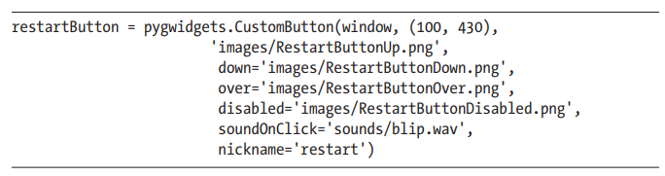
CustomButtons
The CustomButton class allows you to use your own art for a button. To instantiate a CustomButton, you need only pass in a window, a location, and a path to the image of the up state of the button. Here is an example:
The down, over, and disabled states are optional keyword arguments, and for any of these where no value is passed in, CustomButton will use a copy of the up image. It’s more typical (and strongly suggested) to pass in paths for the optional images, like so:
Here we also specified a sound effect that should be played when the user clicks the button, and we provided an internal nickname we can use later

Slide 24
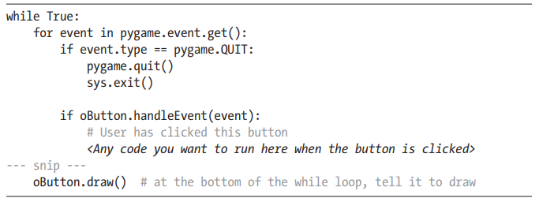
Using Buttons
After instantiation, here’s some typical code to use a button object, oButton, independent of it being a TextButton or a CustomButton:
Every time we detect an event, we need to call the handleEvent() method of the button to allow it to react to the user’s actions. This call normally returns False but will return True when the user completes a click on the button. At the bottom of the main while loop, we need to call the draw() method of the button to allow it to draw itself.

Slide 25
Text Output and Input
As we saw in Chapter 6, handling text input and output in pygame is tricky, but here I’ll introduce new classes for a text display field and an input text field. Both of these classes have minimal required (positional) parameters, and they have reasonable defaults for other attributes (font, font size, color, and so on) that are easily overridden.
The pygwidgets package contains a DisplayText class for showing text that is a more full-featured version of the SimpleText class from Chapter 6. When you instantiate a DisplayText field, the only required arguments are the window and the location. The first keyword parameter is value, which may be specified with a string as starting text to be shown in the field. This is typically used for a default end user value or for text that never changes, like a label or instructions. Since value is the first keyword parameter, it can be given as either a positional or a keyword argument. For example, this:
will work the same way as this:

Slide 26
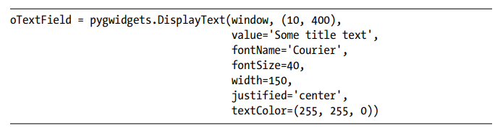
Text Output
You can also customize the look of the output text by specifying any or all of the optional keyword parameters. For example:
The DisplayText class has a number of additional methods, the most important of which is setValue(), which you call to change the text drawn in the field:
At the bottom of the main while loop, you need to call the object’s draw() method:
And of course, you can create as many DisplayText objects as you wish, each displaying different text and each with its own font, size, color, and so on.

Slide 27
Text Input
In a typical text-based Python program, to get input from the user you would make a call to the input() function, which stops the program until the user enters text in the shell window. But in the world of event-driven GUI programs, the main loop never stops. Therefore, we must use a different approach.
For text input from the user, a GUI program typically presents a field that the user can type in. An input field must deal with all keyboard keys, some of which show while others are used for editing or cursor movement within the field. It must also allow for the user holding down a key to repeat it. The pygwidgets InputText class provides all this functionality.
The only required arguments to instantiate an InputText object are the window and a location:

Slide 28
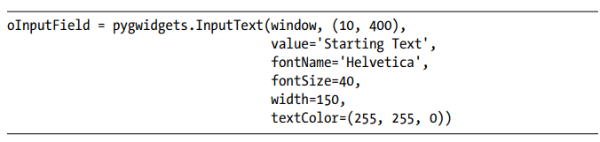
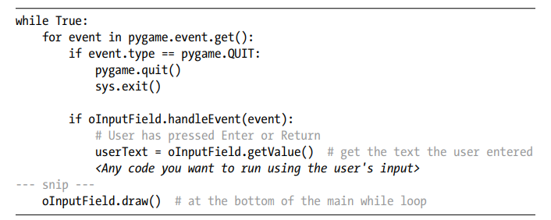
TEXT INPUT
However, you can customize the text attributes of an InputText object by specifying optional keyword arguments:
After instantiating an InputText field, the typical code in the main loop would look like this:

Slide 29
TEXT INPUT
For every event, we need to call the handleEvent() method of the InputText field to allow it to react to keystrokes and mouse clicks. This call normally returns False, but when the user presses ENTER or RETURN, it returns True. We can then retrieve the text that the user entered by calling the getValue() method of the object.
At the bottom of the main while loop, we need to call the draw() method to allow the field to draw itself.
If a window contains multiple input fields, key presses are handled by the field with current keyboard focus, which is changed when a user clicks in a different field. If you want to allow a field to have initial keyboard focus, then you can set the initialFocus keyword parameter to True in the InputText object of your choice when you create that object. Further, if you have multiple InputText fields in a window, a typical user interface design approach is to include an OK or Submit button. When this button is clicked, you could then call the getValue() method of each field

Slide 30

Other pygwidgets Classes
As you saw at the beginning of this section, pygwidgets contains a number of other classes.
The ImageCollection class allows you to show any single image from a collection of images. For example, suppose you have images of a character facing front, left, back, and right. To represent all the potential images, you can build a dictionary like this:
You can then create an ImageCollection object, specifying this dictionary and the key of the image you want to start with. To change to a different image, you call the replace() method and pass in a different key. Calling the draw() method at the bottom of the loop always shows the current image.
The Dragger class displays a single image but allows the user to drag the image anywhere in the window. You must call its handleEvent() method in the event loop. When the user finishes dragging, handleEvent() returns True, and you can call the Dragger object’s getMouseUpLoc() method to get the location where the user released the mouse button.
The Animation and SpriteSheetAnimation classes handle building and showing an animation. Both require a set of images to iterate through. The Animation class gets the images from individual files, while the SpriteSheetAnimation class requires a single image with evenly spaced internal images.

Slide 31
The Importance of a Consistent API
One final note about building an API for a set of classes: whenever possible, it’s a very good idea to build consistency into the parameters of methods in different, but similar, classes. As a good example, the first two parameters to the __init__() method of every class in pygwidgets are window and loc, in that order. If these had been in a different order in some calls, using the package as a whole would be much more difficult.
Additionally, if different classes implement the same functionality, it’s a good idea to use the same method names. For example, many of the classes in pygwidgets have a method named setValue() and another named getValue(). I’ll talk more about why this type of consistency is so important in the next two chapters.

Slide 32
Summary
This chapter provided an introduction to the object-oriented pygwidgets package of graphical user interface widgets. We began by discussing default values for parameters in methods, and I explained that a keyword parameter allows for a default value to be used if no matching argument value is specified in a call.
I then introduced you to the pygwidgets module, which contains a number of prebuilt GUI widget classes, and showed you how to use several of these. Finally, I showed a sample program that provides examples of most of these widgets.
There are two key advantages to writing classes like those in pygwidgets. First, classes can hide complexity in methods. Once you have your class working correctly, you never have to worry about the internal details again. Second, you can reuse the code by creating as many instances of a class as you need. Your classes can provide basic functionality by including keyword parameters with well-chosen default values. However, the default values can easily be overwritten to allow for customization.
You can publish the interfaces of your classes for other programmers (and yourself) to take advantage of in different projects. Good documentation and consistency go a long way toward making these types of classes highly usable

